Slide 2

Welcome

Slide 3
Parameters Driving Interactivity One Dashboard at a Time
#Data17
Nena Ballas
Manager, Product Consulting
Tableau
Rachel Robinson
Senior Product Consultant
Tableau

Slide 4


Your Parameters Team
Nena Ballas
Rachel Robinson

Slide 5

Objectives
Broaden your Tableau toolkit
Create new visual interactivity
Improve end-user experience

Slide 6
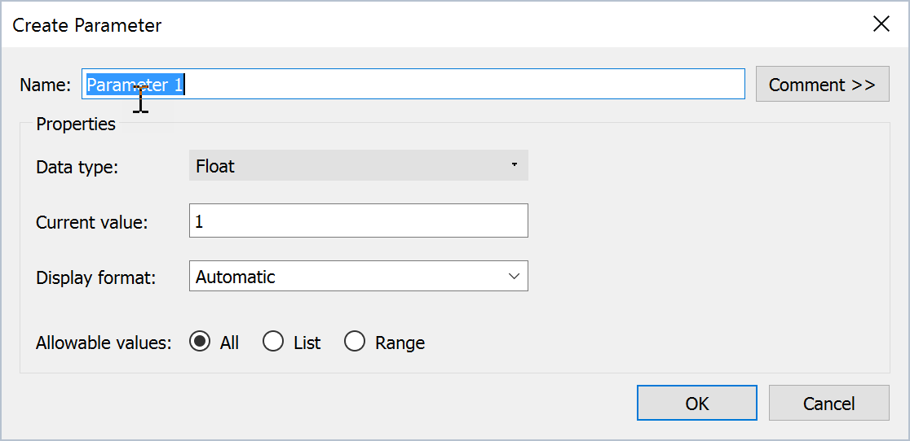
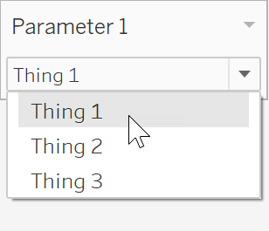
What is a parameter?
Parameters are dynamic values that can replace constant values.
In Tableau, parameters are used to extend interactivity.
Customize values
Change thresholds
Dynamic dimensions

Slide 7
Agenda
Bin Sizes
Top and Bottom N
Moving Average
Dynamic Dates
Key Performance Indicators
Field Swapping
Sheet Swapping
…and more!

Slide 8
Resources
On your desktop:
Starting Workbook
Completed Workbook
Guided Website
Around the room:
Room Assistants

Slide 9

Break!

Slide 10
SESSION REPEATS
Day of Week, Month Day Session Title
Time – Time | Location
Day of Week, Month Day Session Title
Time – Time | Location
Day of Week, Month Day Session Title
Time – Time | Location

Slide 11
RELATED SESSIONS
Friday, October 23 Beginning Your Geographic Analysis Journey
11:30am – 12:30pm | Location
Friday, October 23 Beginning Your Geographic Analysis Journey
11:30am – 12:30pm | Location
Friday, October 23 Beginning Your Geographic Analysis Journey
11:30am – 12:30pm | Location

Slide 12
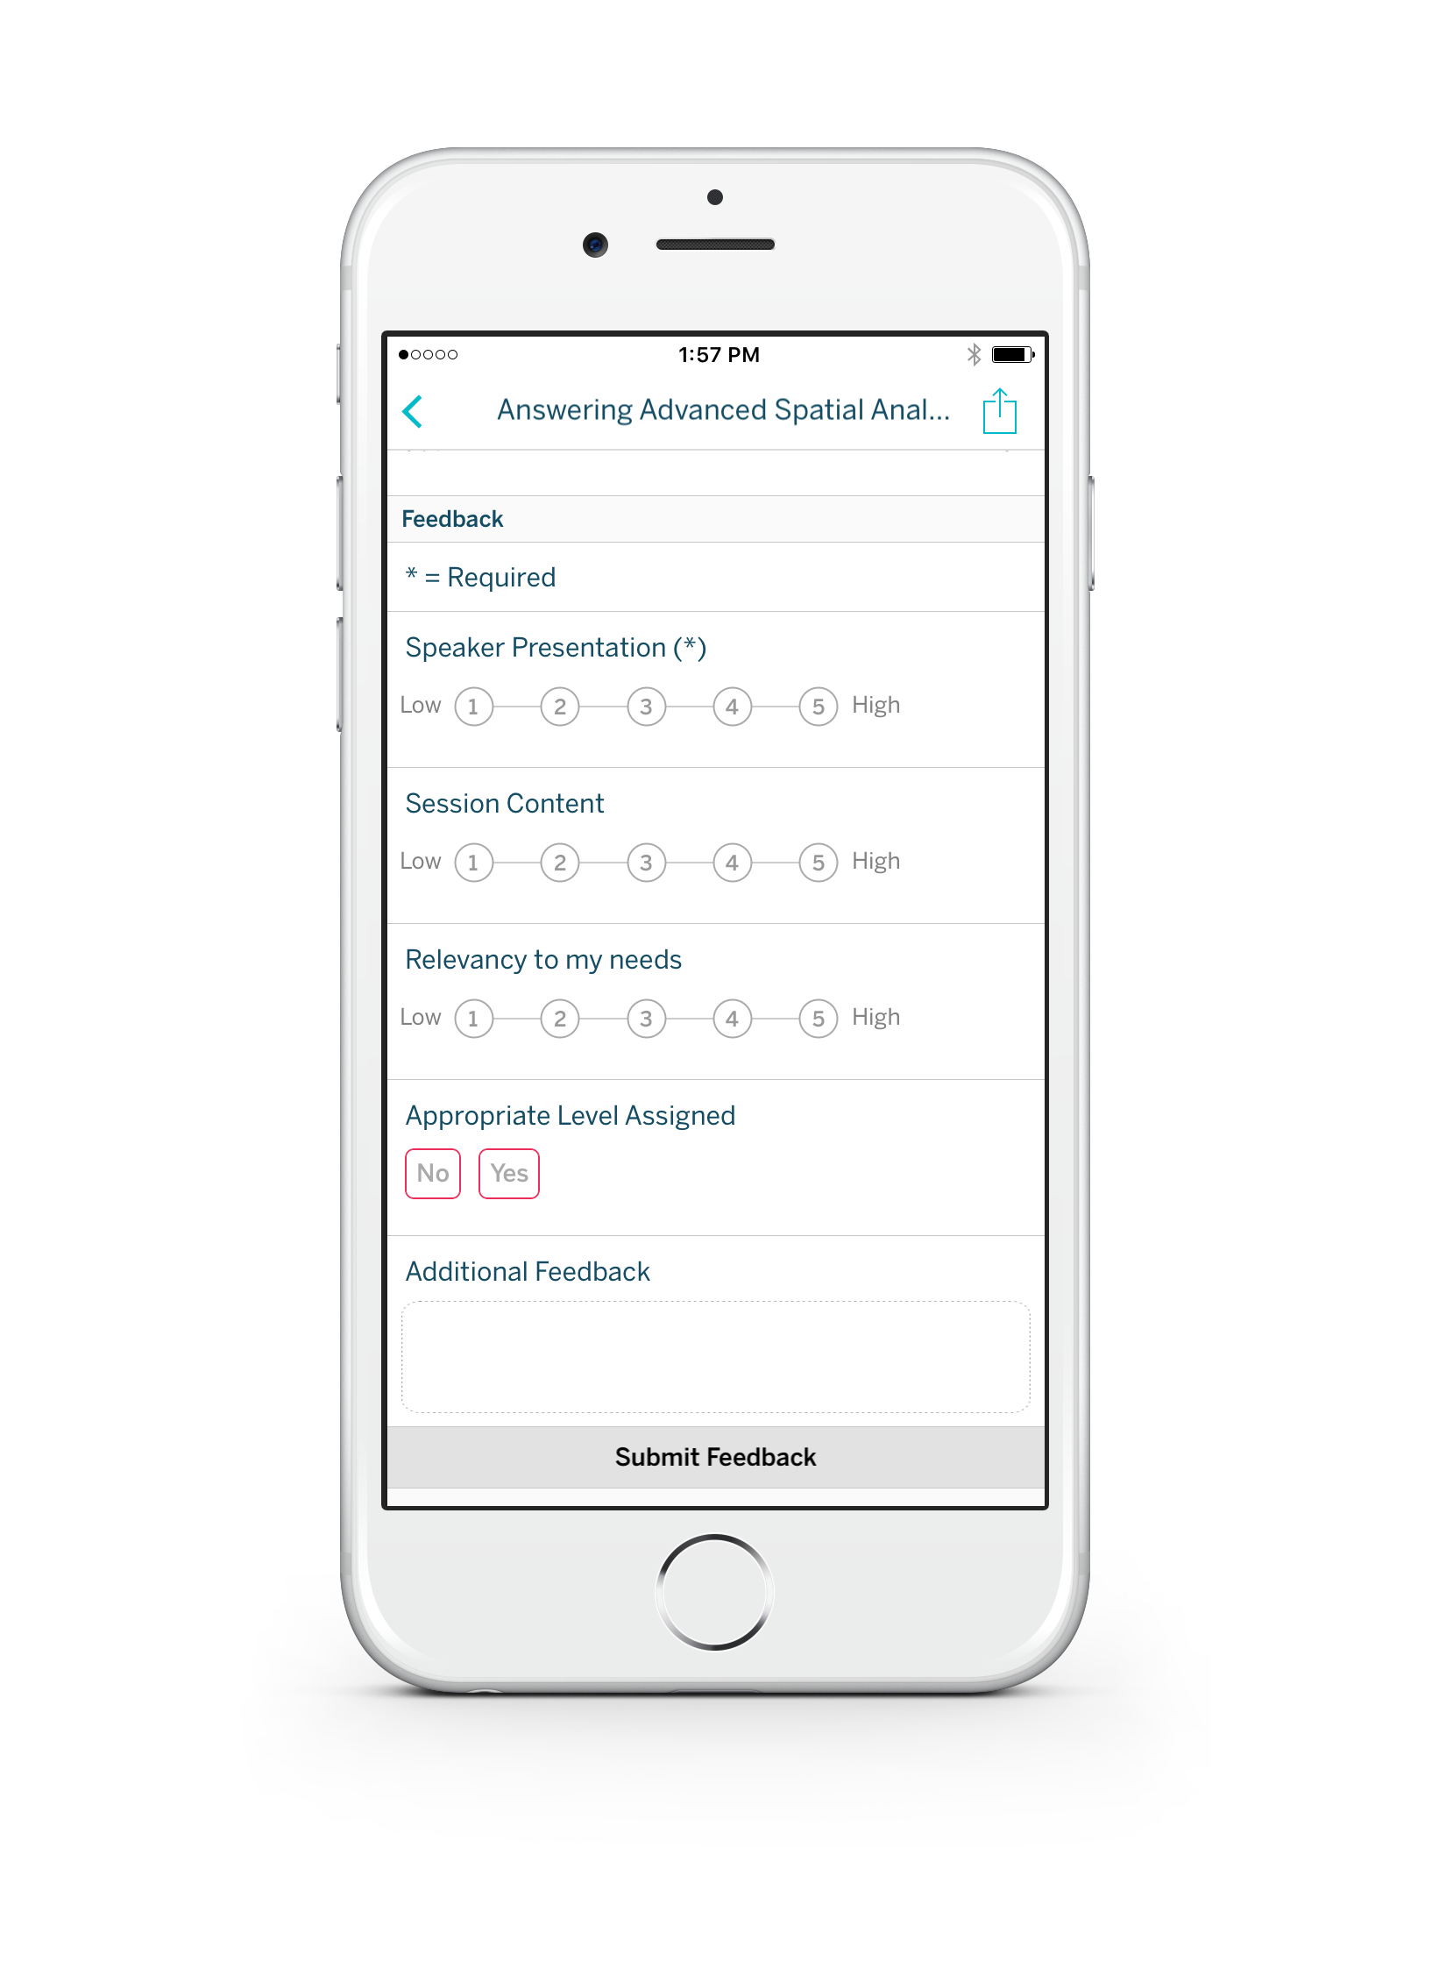
Please complete the session survey from the Session Details screen in your TC17 app

